Slide 2
We stayed at the Mandalay and worked with their workers

Slide 3
Doug and Paul with a local Pastor in Henderson, Nevada

Slide 4
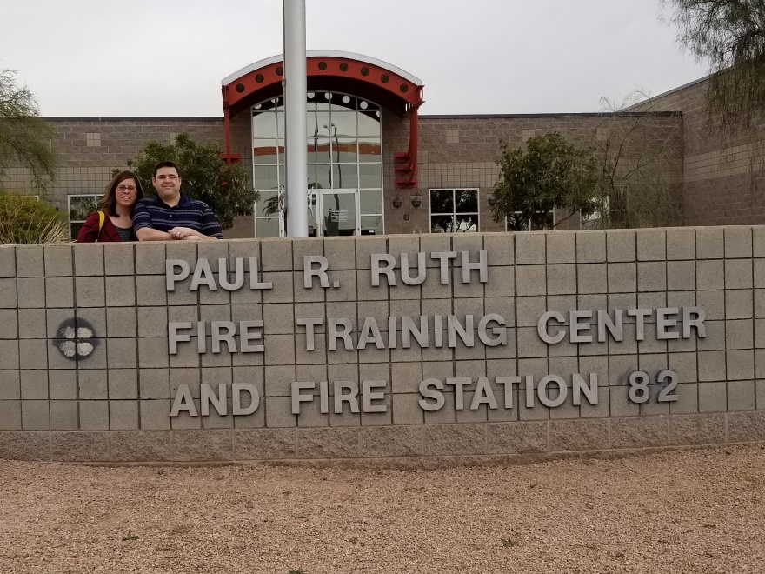
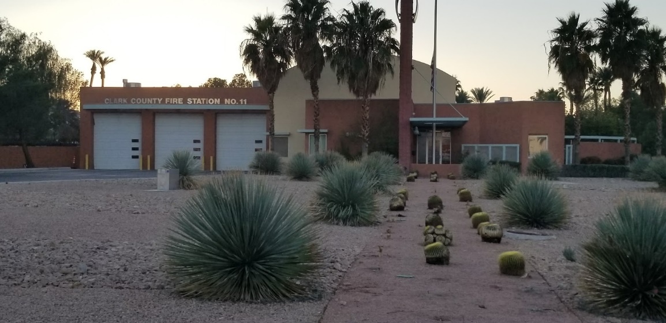
A few of the Fire Stations that we visited

Slide 5
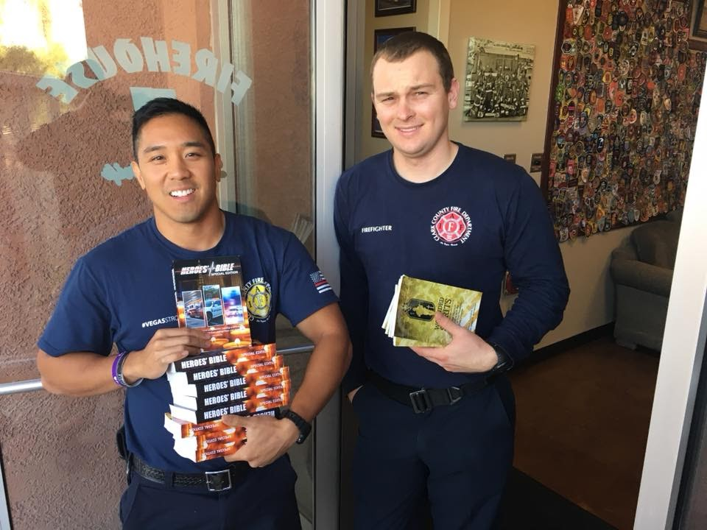

Slide 6
Sarah and Debbie at one of the fire Stations

Slide 7
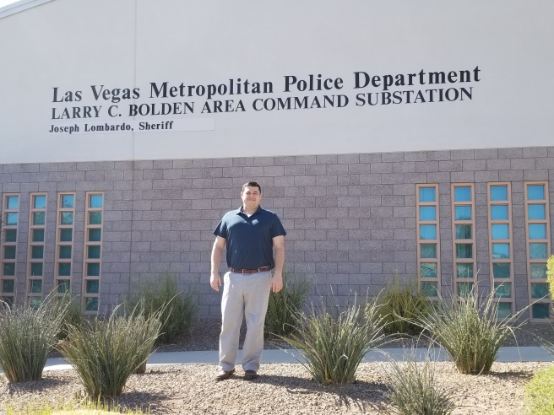
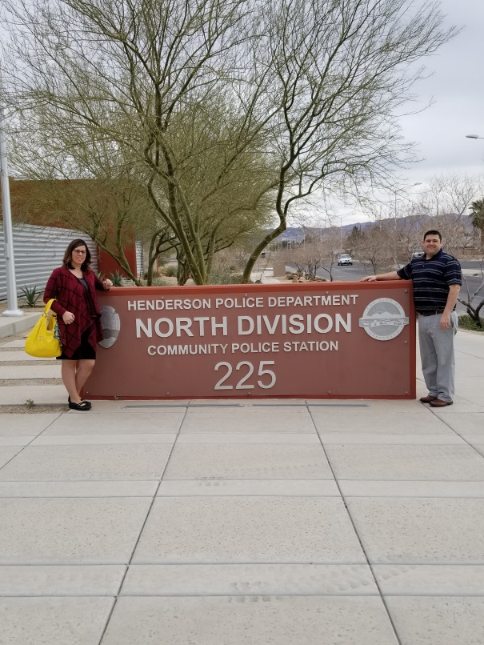
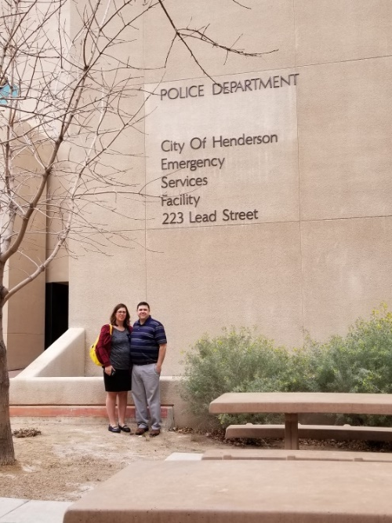
A few Police stations that were visited

Slide 8
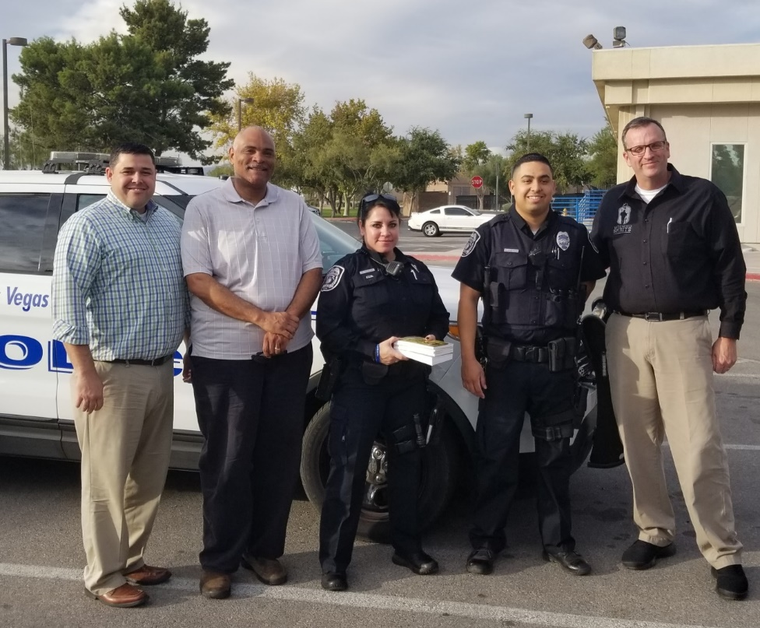
Visiting North Vegas police officers

Slide 9
Phelps’s, Carragher’s, a Chaplain, and Captain of Las Vegas Metro Police Department

Slide 10
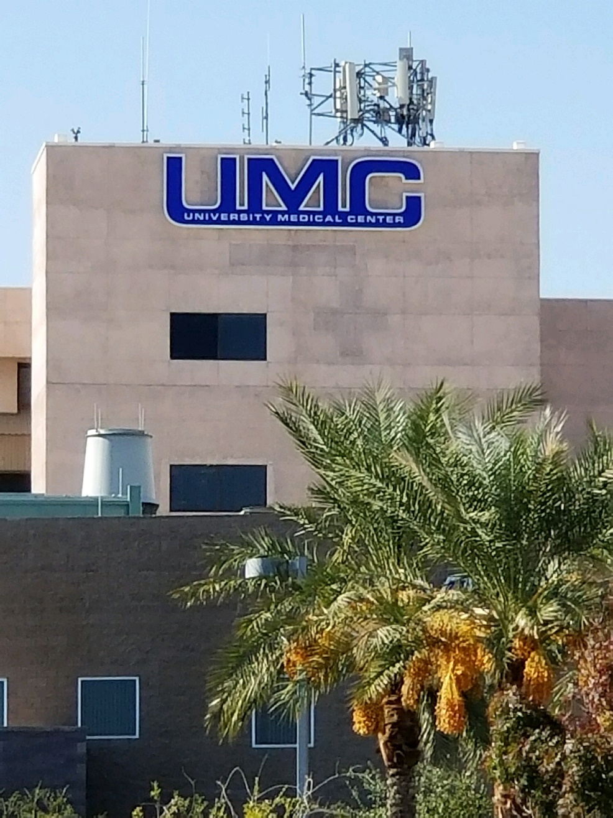
Medical Center

Slide 11
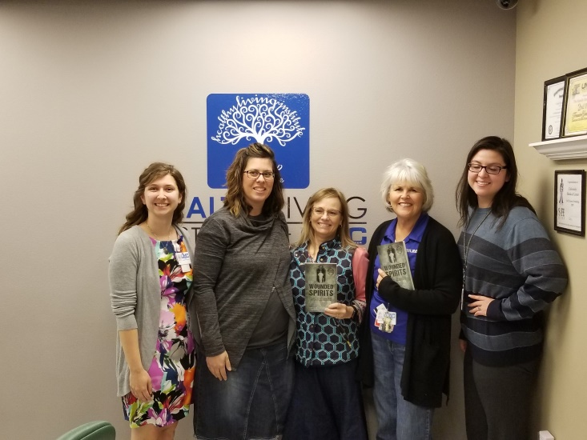
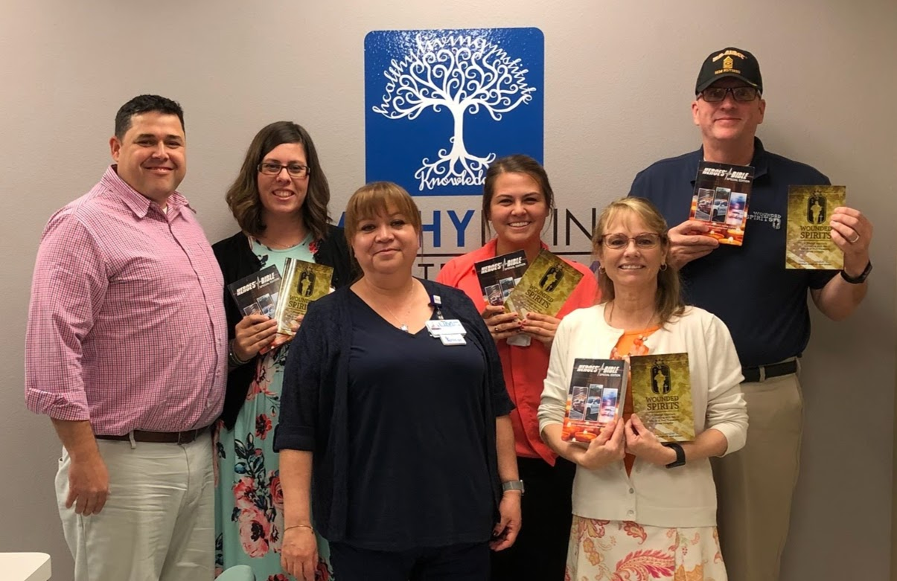
Trauma Unit at UMC in Las Vegas

Slide 12
One of the Vet Centers we visited and distributed Bibles to

Slide 13
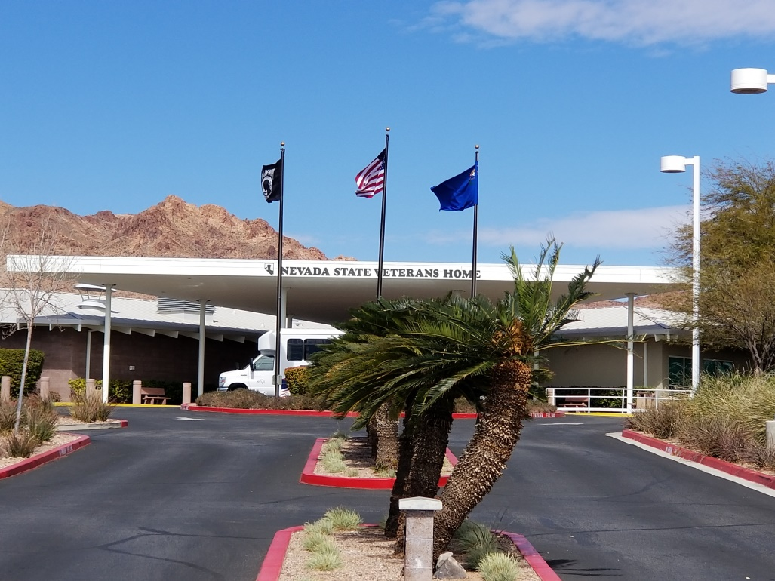
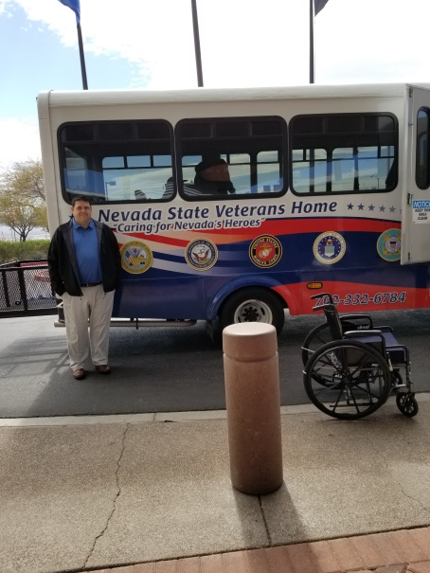
A veterans home

Slide 14
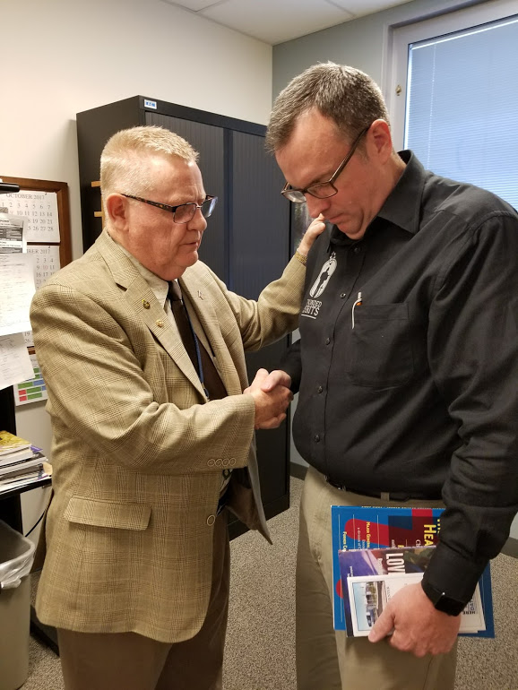
VA Medical Center

Slide 15
The Fisher House at the VA

Slide 16
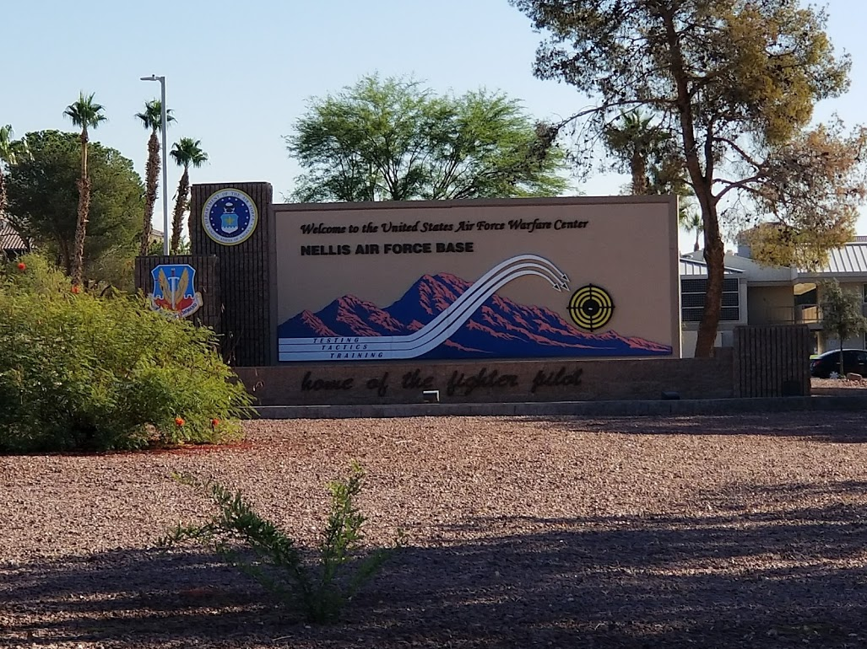

Slide 17
Visiting the memorials

Slide 18
List of those who lost their lives at the concert

Slide 23
Paul with someone who lost a loved one during the Las Vegas tragedy

Slide 24
The new memorial

Slide 26
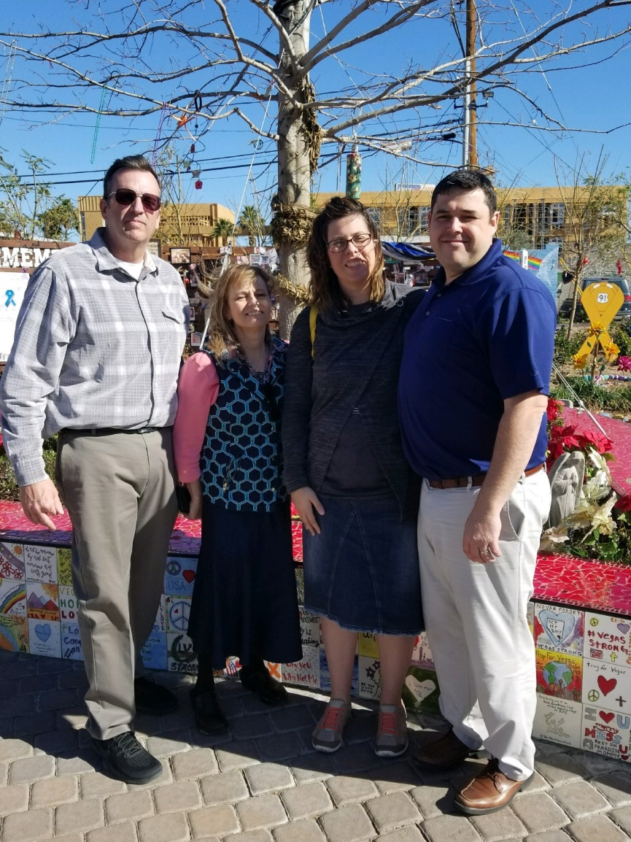
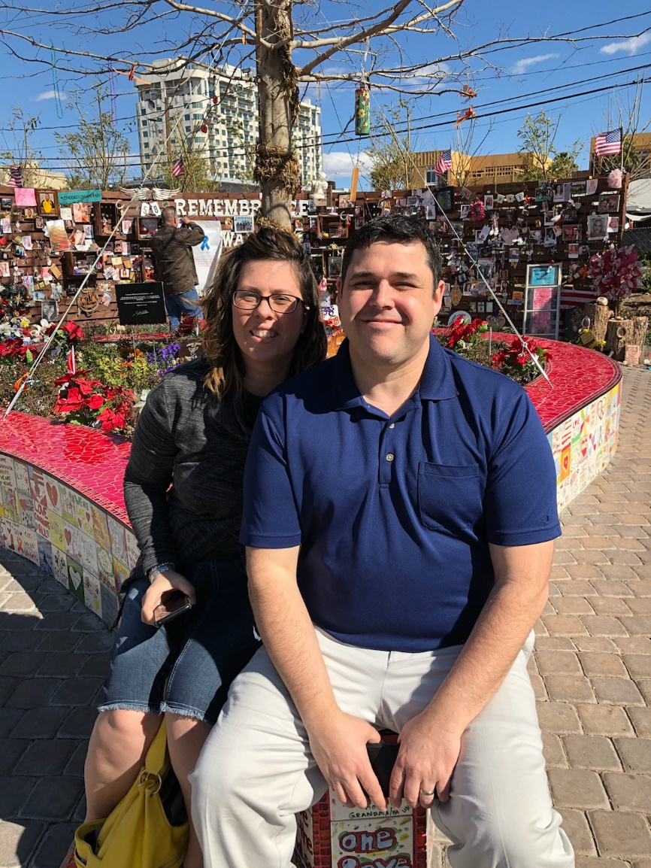

Slide 27
AFBM display set up for church on Sunday

Slide 28
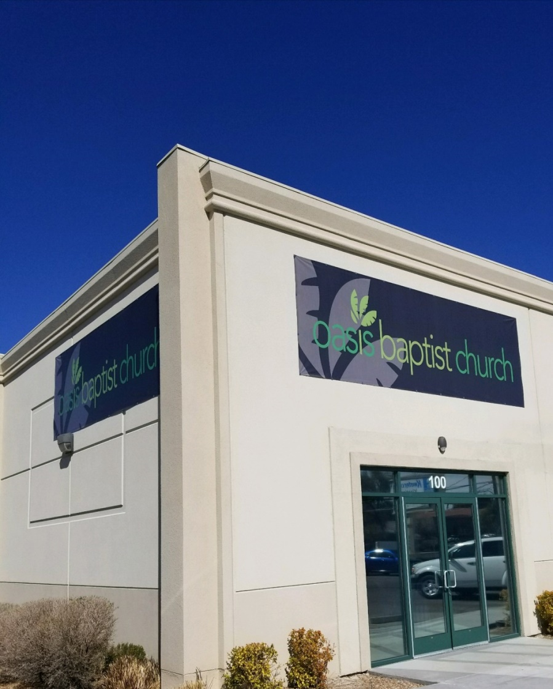
Where we held the Wounded Spirits Conference

Slide 29
Sarah and Debbie working the registration table

Slide 30
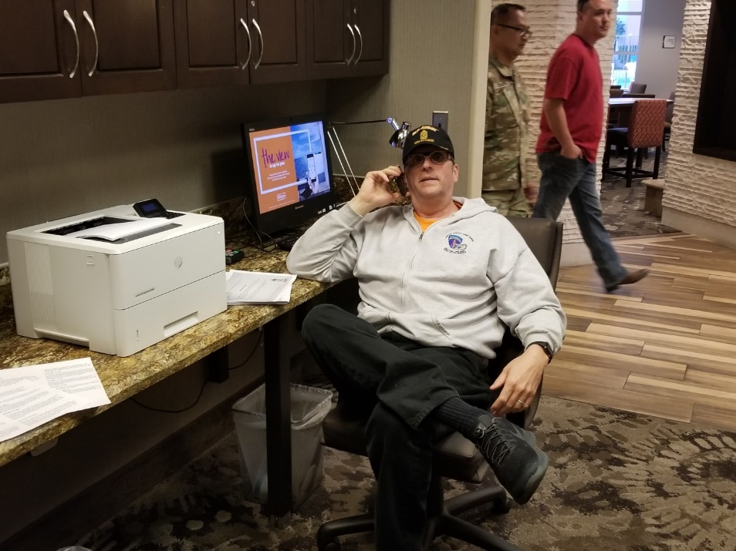
Our Command Center

Slide 31
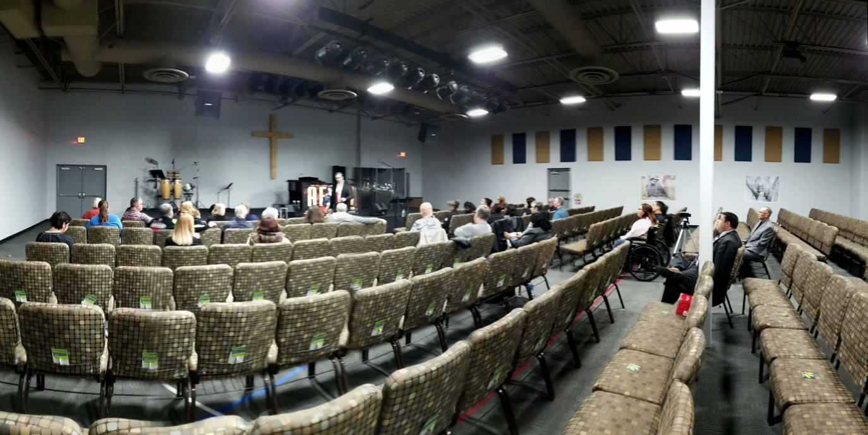
Doug teaching one of the sessions

Slide 32
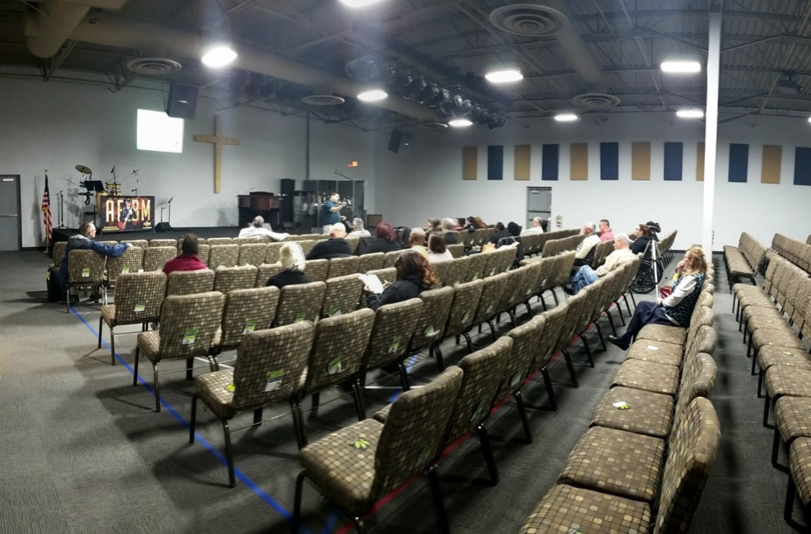
Paul teaching one of the sessions

Slide 33
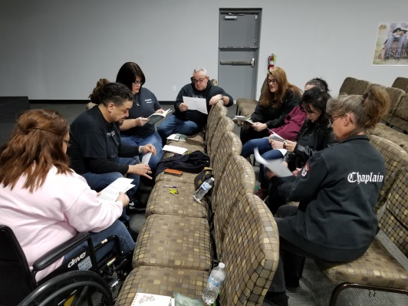
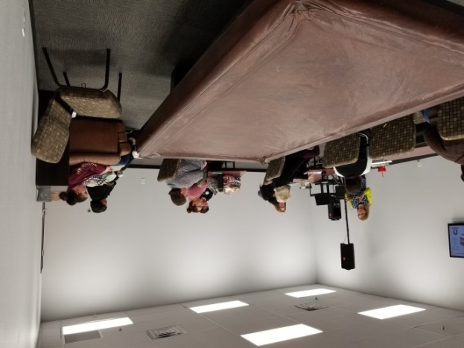
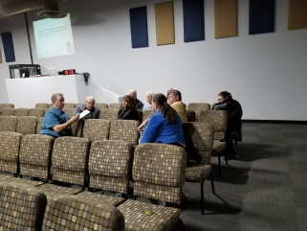
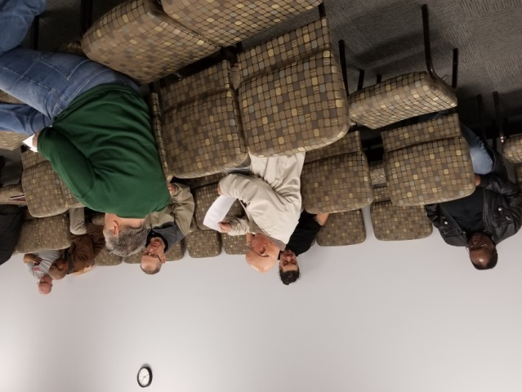
Case study groups

Slide 34
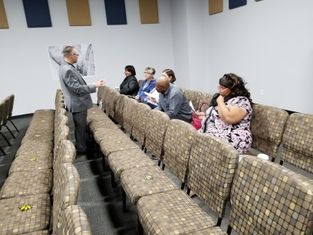
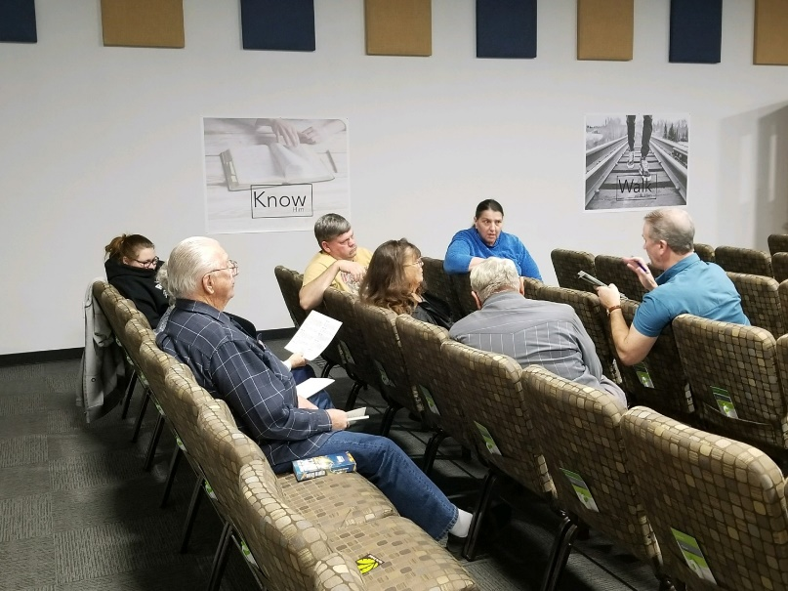
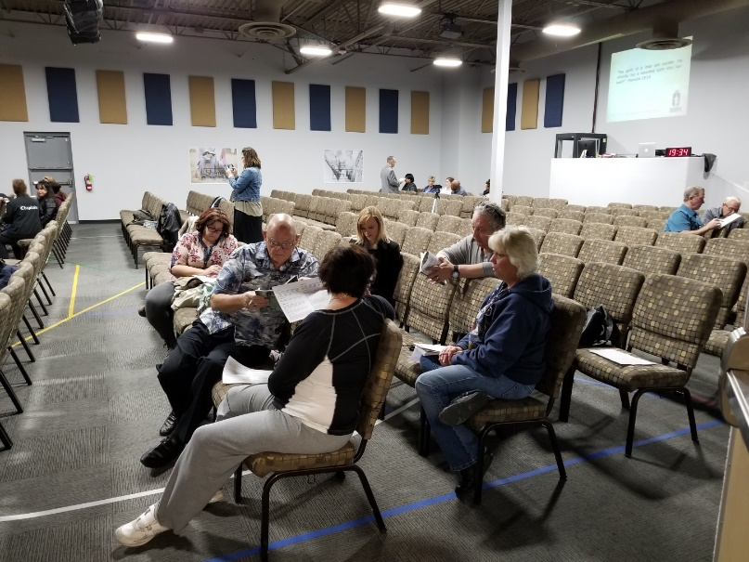
Case study groups

Slide 35
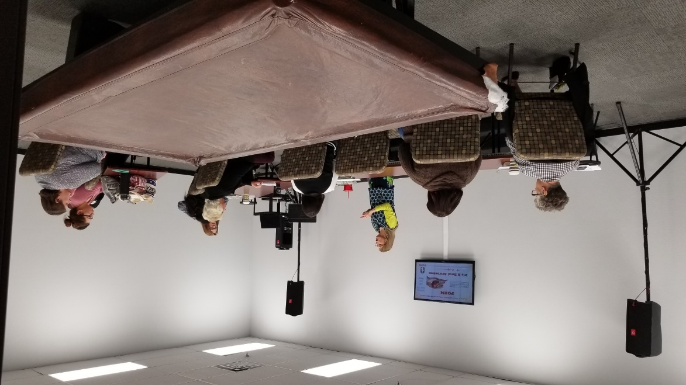
Ladies breakout sessions

Slide 36
Las Vegas Chaplains saying thank you

Slide 37
Q & A Time

Slide 38
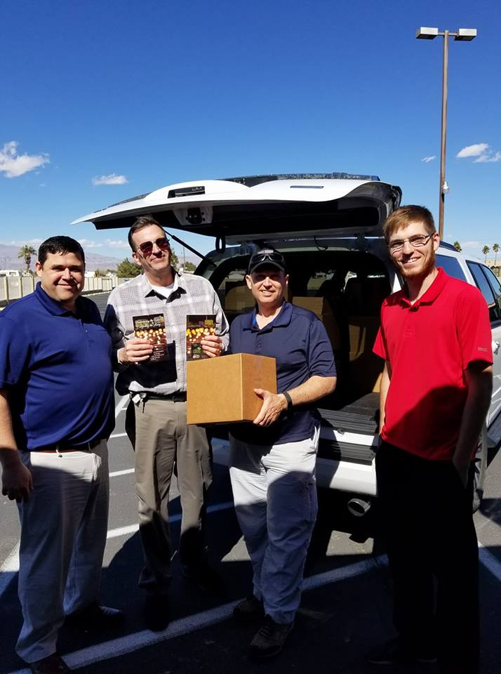
A few important things that were accomplished
since the beginning of Operation Las Vegas
More than 17,000 John and Romans Bibles were passed out
More than 1,200 Hope Bibles were passed out
More than 600 First responder Bibles were passed out
More than 800 Wounded Spirits books were passed out
11 people and counting have been led to the Lord.
Many have been witnessed to
More than 50 attended the Wounded Spirits Conference
Many have made life changing decisions

